Slide 1
Meeting Minutes to Agile Artifacts

Slide 2
agenda
Use Case
Architecture
Technology Stack

Slide 3
Use Case
Objective: To automate the creation of user stories and acceptance criteria from recorded meetings between developers and testers.
Flow:
Audio Upload: The user uploads an audio file of the meeting (e.g., .wav, .mp3) to the UI.
Automatic Transcription:
The system transcribes the audio using a speech-to-text engine (e.g., Google Cloud Speech-to-Text, AssemblyAI).
Python libraries (e.g., SpeechRecognition, pyaudio, librosa) extract text from the audio file.
This step can be optional, allowing users to provide their own transcripts.
Text Cleaning & Processing:
The transcribed text is cleaned (punctuation, capitalization, etc.) and potentially summarized for better LLM processing.
Embedding Generation:
Key phrases and sentences related to user stories and acceptance criteria are extracted.
These phrases are converted into vector embeddings using a suitable model (e.g., Sentence Transformers).
Contextual Enrichment:
Relevant information from existing project documentation (e.g., Jira tickets, design documents) is retrieved and also converted into embeddings.

Slide 4
6. Prompt Engineering:
User provides a custom prompt (e.g., "Based on the following meeting transcript, generate user stories for the [project/feature]...") in the UI.
7. Similarity Search:
The meeting transcript embeddings are compared to the embeddings from project documentation to find relevant context.
8.. LLM Generation:
The prompt and the context (either directly or through vector similarity search) are fed to an LLM (e.g., GPT-3, Bard, Llama 2).
The LLM (e.g., GPT-3, Bard) is prompted to generate user stories and acceptance criteria based on:
The cleaned and potentially summarized meeting transcript.
The relevant context retrieved from project documentation.
9. Output Refinement:
The generated output is presented to the user for review and refinement.
The user can edit the generated text, add or modify details, and ultimately approve the final output.
10. Integration:
The approved user stories and acceptance criteria can be automatically integrated into project management tools (e.g., Jira).

Slide 5
Architecture
Components:
Frontend (Streamlit/Gradio): User interface for file upload, transcription (optional), output display, and user interaction.
Backend (Python):
Audio Processing: Handles audio upload and transcription.
Text Processing: Cleans, summarizes, and extracts key phrases.
Embedding Generation: Creates embeddings for meeting transcripts and project documents.
Similarity Search: Finds relevant context using vector similarity search.
LLM Interaction: Interacts with the chosen LLM.
Speech-to-Text Service: (e.g., Google Cloud Speech-to-Text, AssemblyAI)
Vector Database: (e.g., Pinecone, Faiss, Sentence Transformers) to store and query embeddings efficiently.
Project Management Integration: (e.g., Jira API) to automatically create and update tickets.

Slide 6
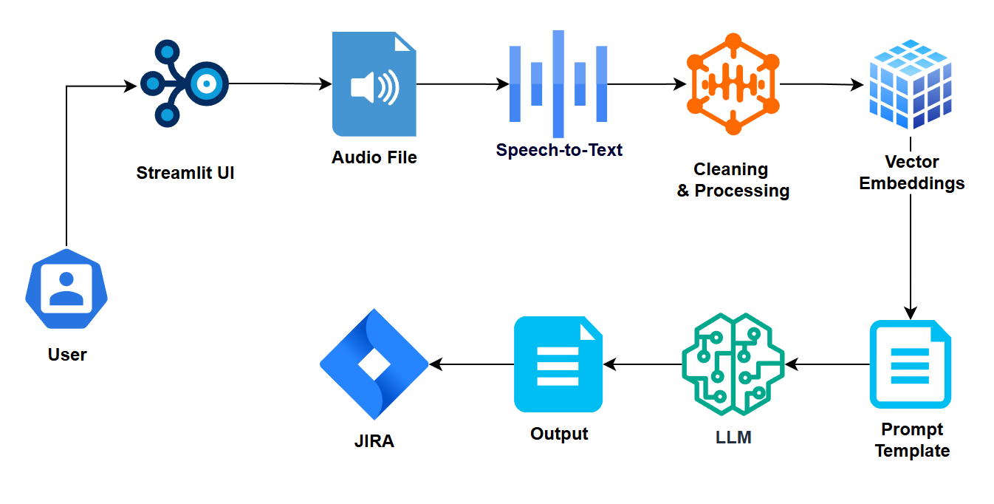
Diagram

Slide 7
Technology stack
Frontend: Streamlit/Gradio
Backend: Python
Audio Processing: SpeechRecognition, pyaudio, AssemblyAI API
Text Processing: NLTK, spaCy
Embedding Generation: Sentence Transformers, PineCone, Faiss…
Vector Database: Pinecone, Faiss
LLM: GPT-3, Bard, Hugging Face Transformers
Project Management Integration: Jira API

Slide 8
Thank you

